Slide 1

New properties in elliptic BILLIARDS
Dan S. Reznik
RONALDO GARCIA
JAIR KOILLER
Rio de Janeiro, september, 2019

Slide 2
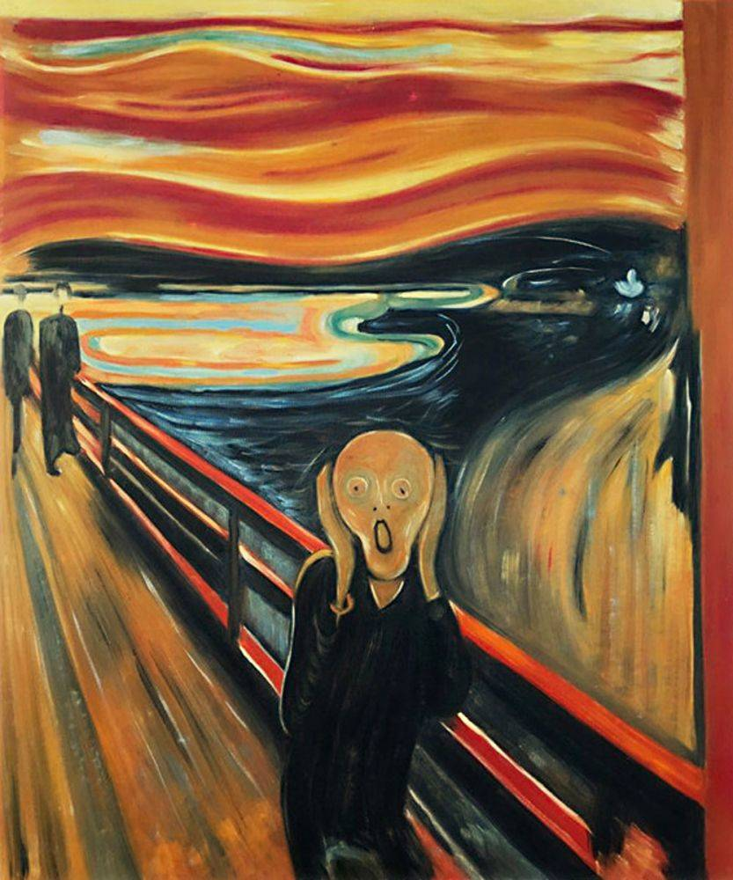
We’re friendly!

Slide 3

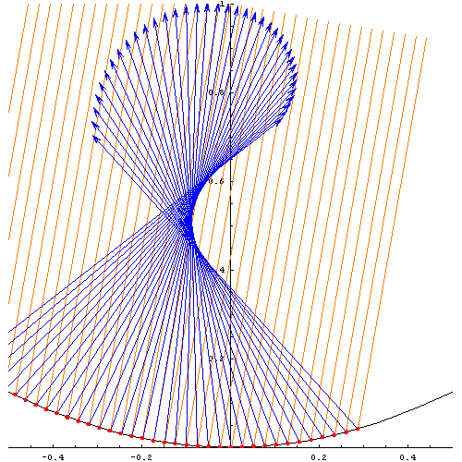
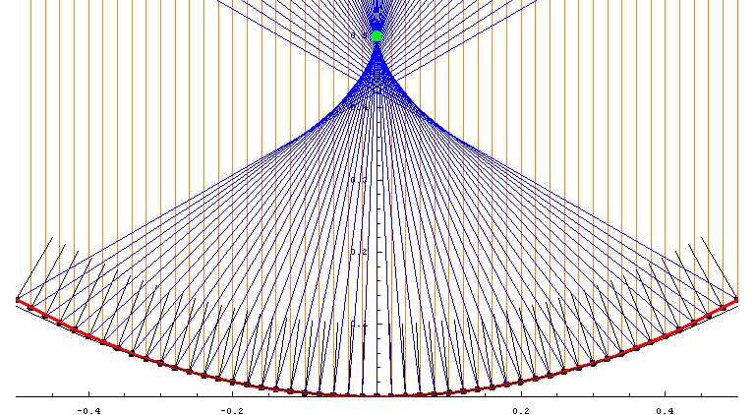
Ray tracing Curved mirRORS 2006

Slide 4
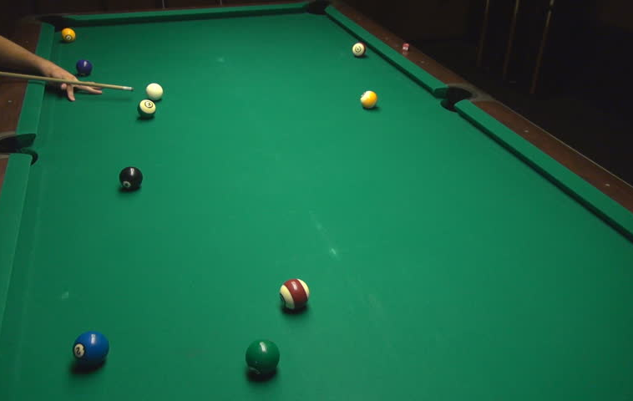
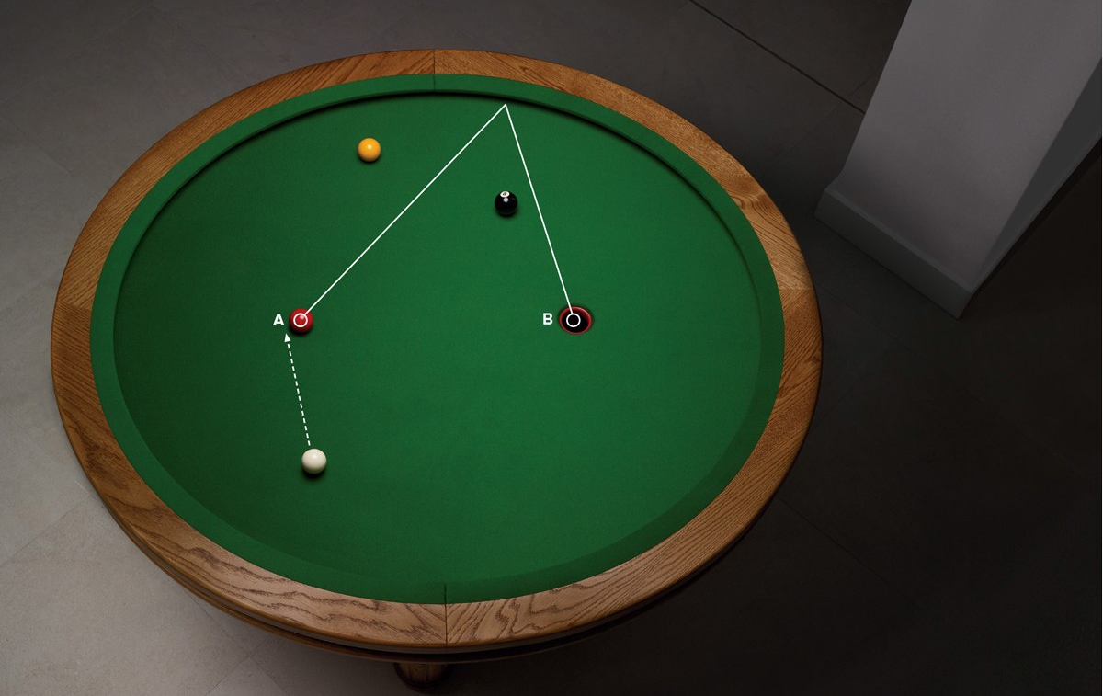
Pool table / jeu de billards

Slide 5
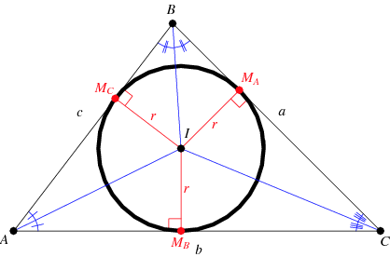
incenter

Slide 6
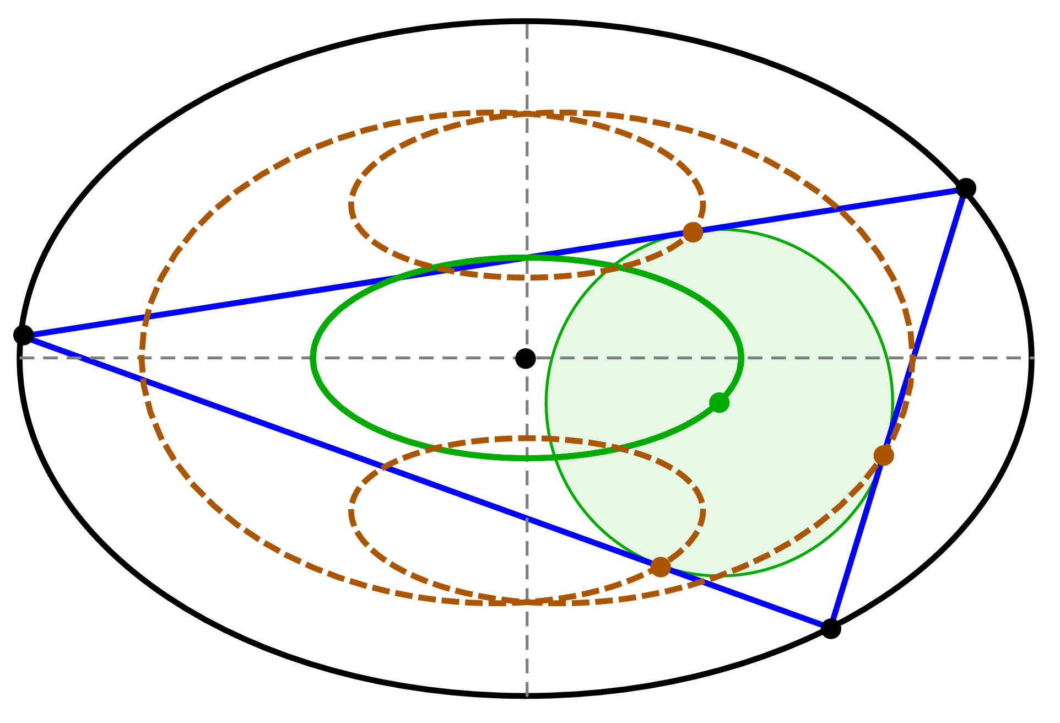
triangular ORBITS (2011) VIDEO 1 VIDEO 2

Slide 7
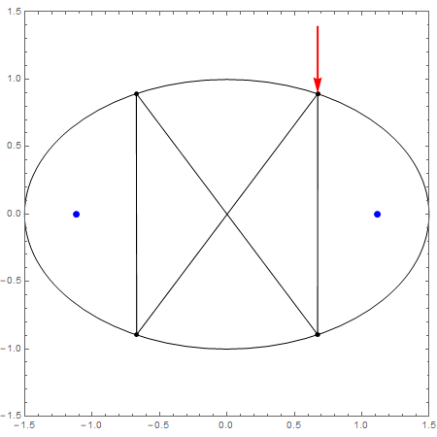
N=4 Self-intersecting VIDEO

Slide 8
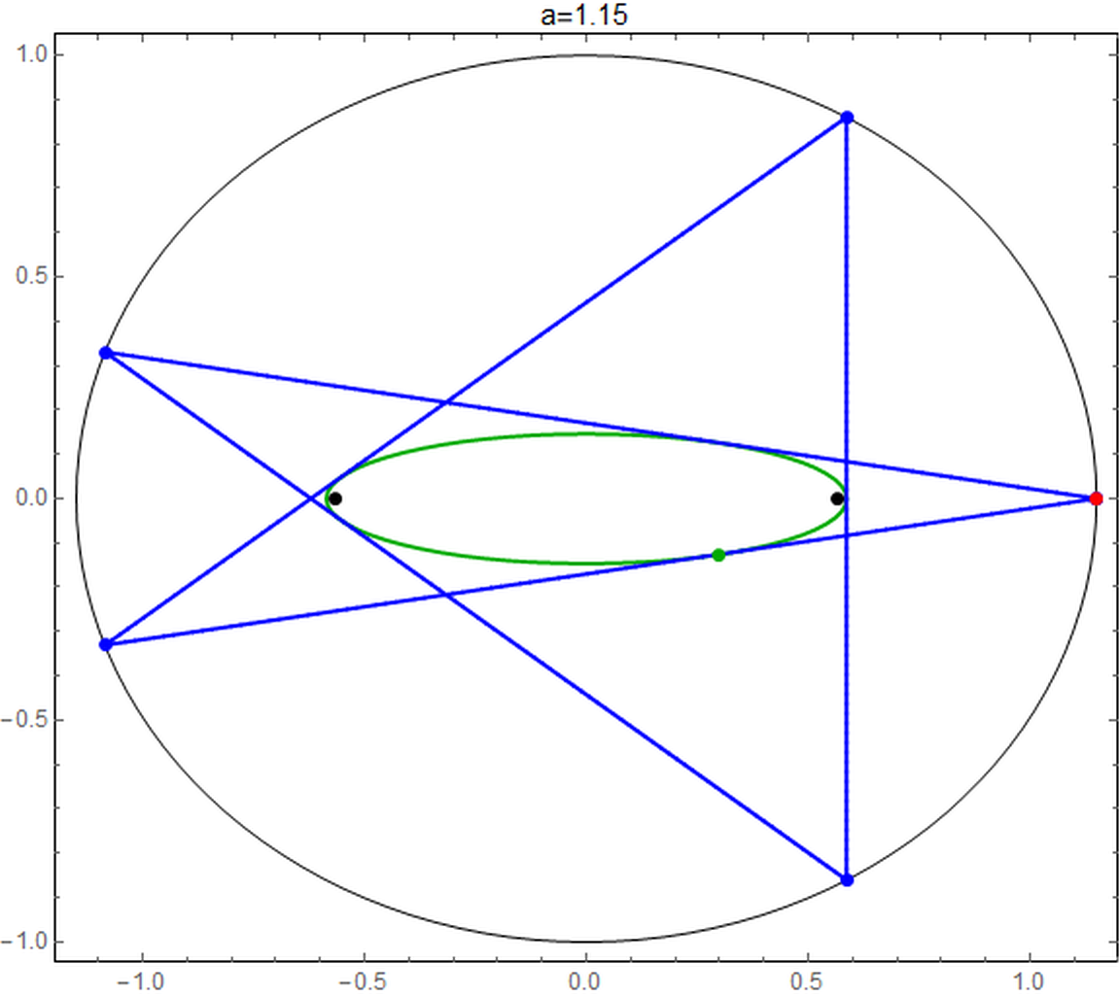
Self-intersecting pentagram video APPLET

Slide 9
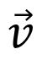
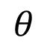
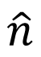
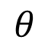
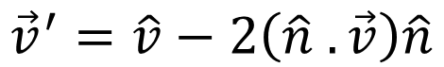
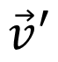
Conservation of linear momentum
$$θ$$
$$θ$$
$$\vec{v}$$
$$\hat{n}$$
$$\vec{v}′$$
$${\vec{v}}^{′}=\hat{v}−2\left(\hat{n} .\vec{v}\right)\hat{n}$$

Slide 10
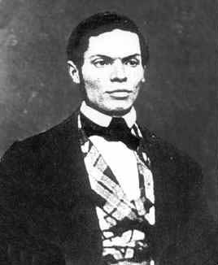
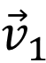
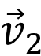
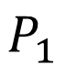
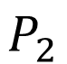
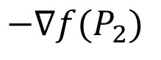
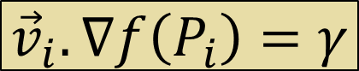
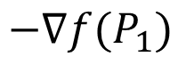
Conservation of momentum
$$P_{1}$$
$${\vec{v}}_{1}$$
$$−∇f(P_{1})$$
Ferdinand Joachimsthal
1818-1861
Confocal “Caustic”
$$−∇f(P_{2})$$
$${\vec{v}}_{2}$$
$$P_{2}$$
$${\vec{v}}_{i}.∇f\left(P_{i}\right)=γ$$

Slide 11
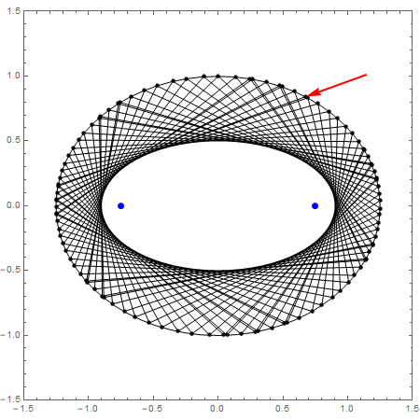
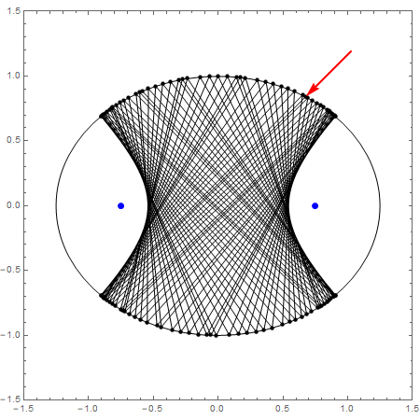
causticS VIDEO

Slide 12
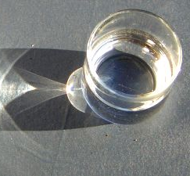
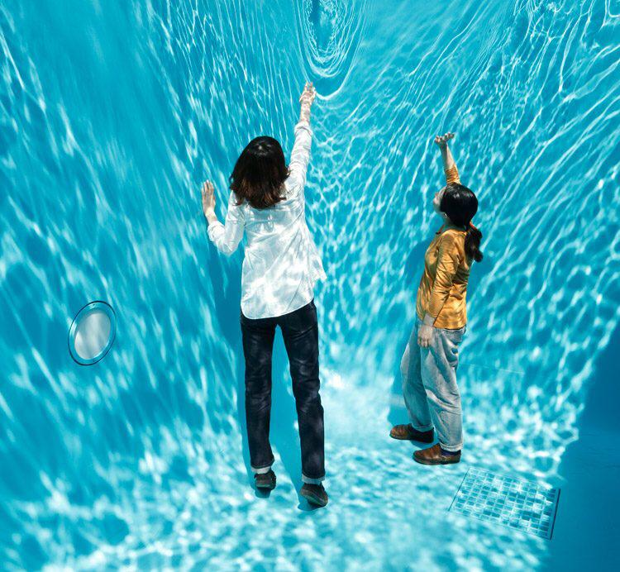

Slide 13
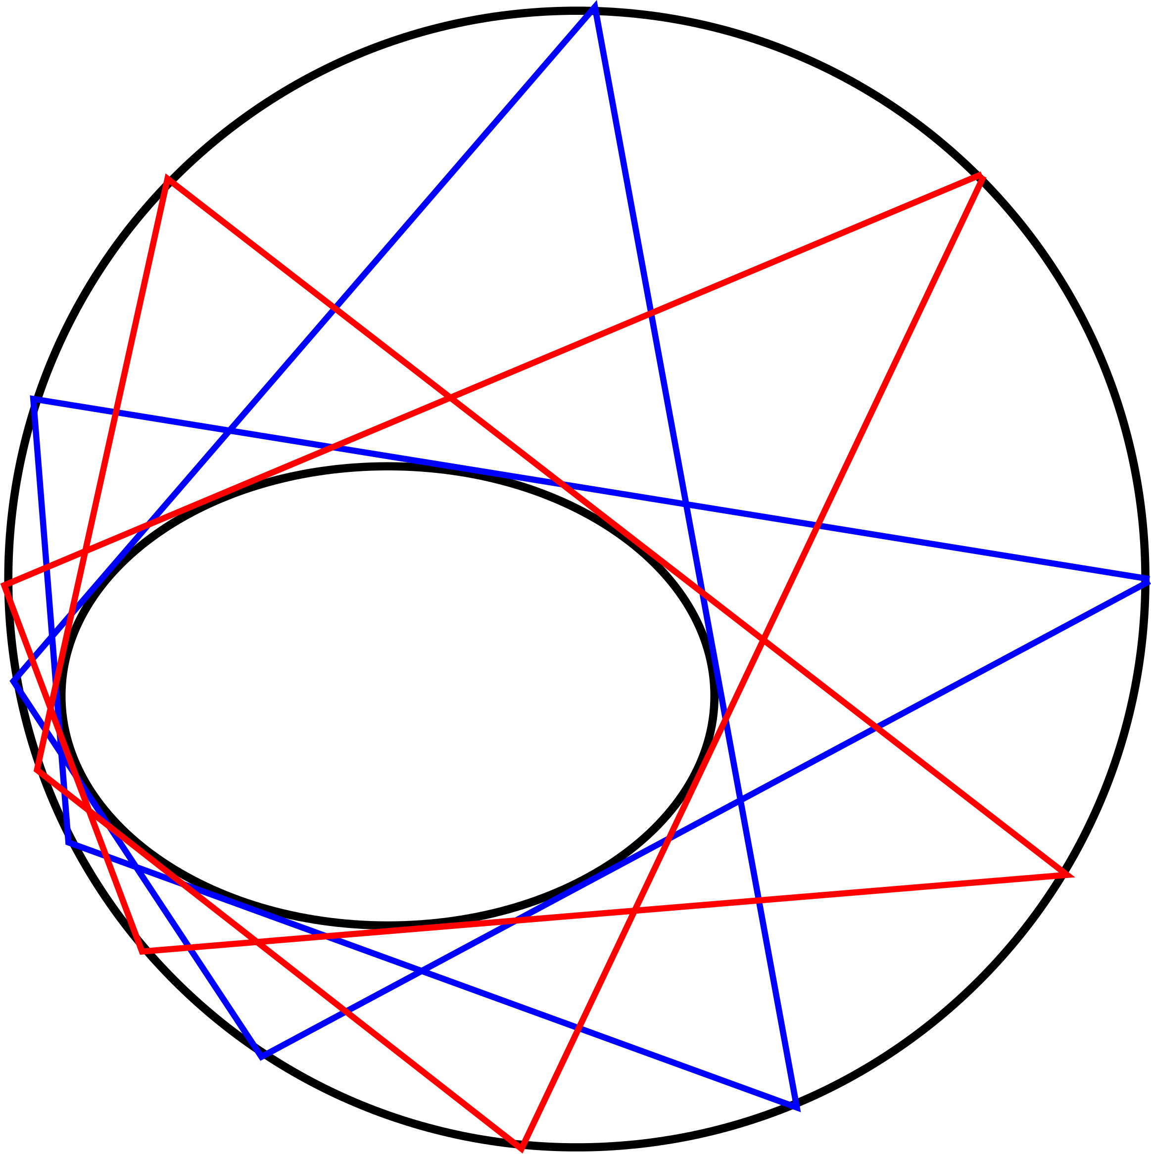
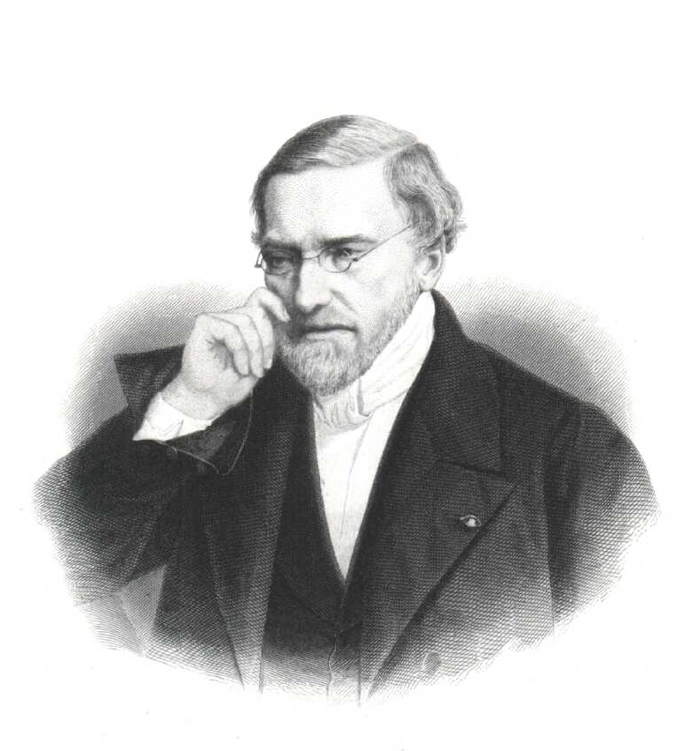
Poncelet “Porism”
Jean-Victor Poncelet
1788–1867

Slide 14
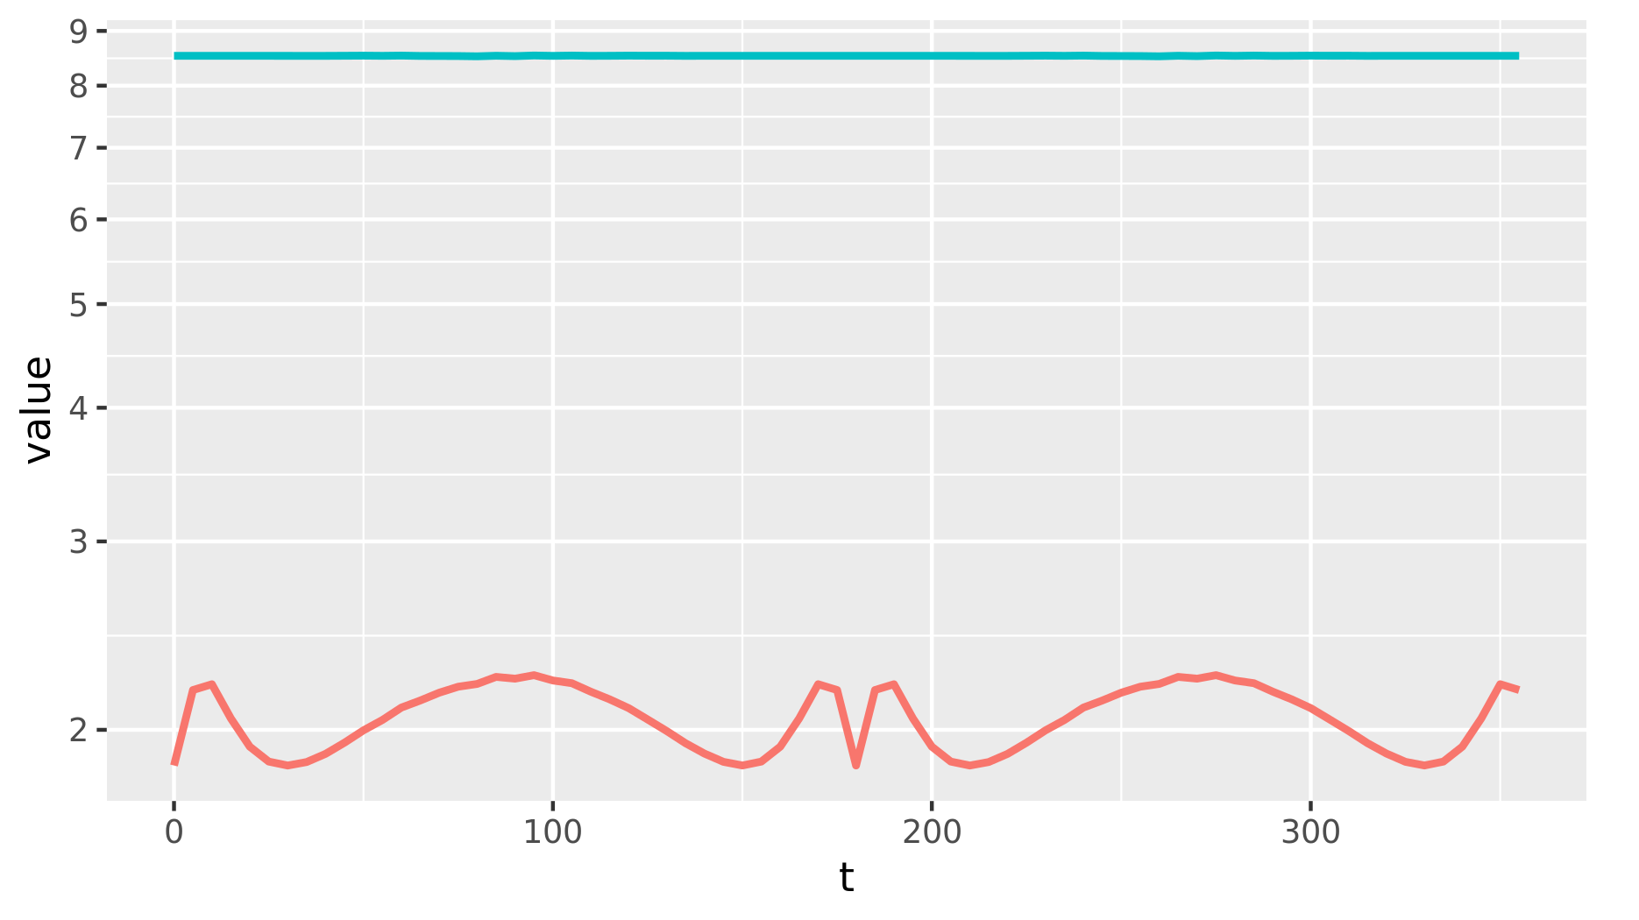
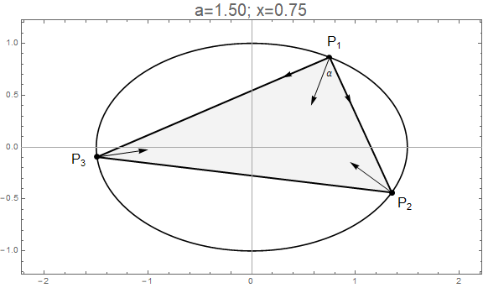
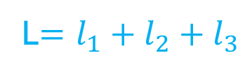
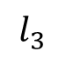
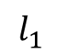
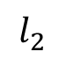
Integrability => constant Perimeter L
t
$$l_{2}$$
L
$$l_{3}$$
A
A
$$l_{1}$$
L$=l_{1}+l_{2}+l_{3}$

Slide 15
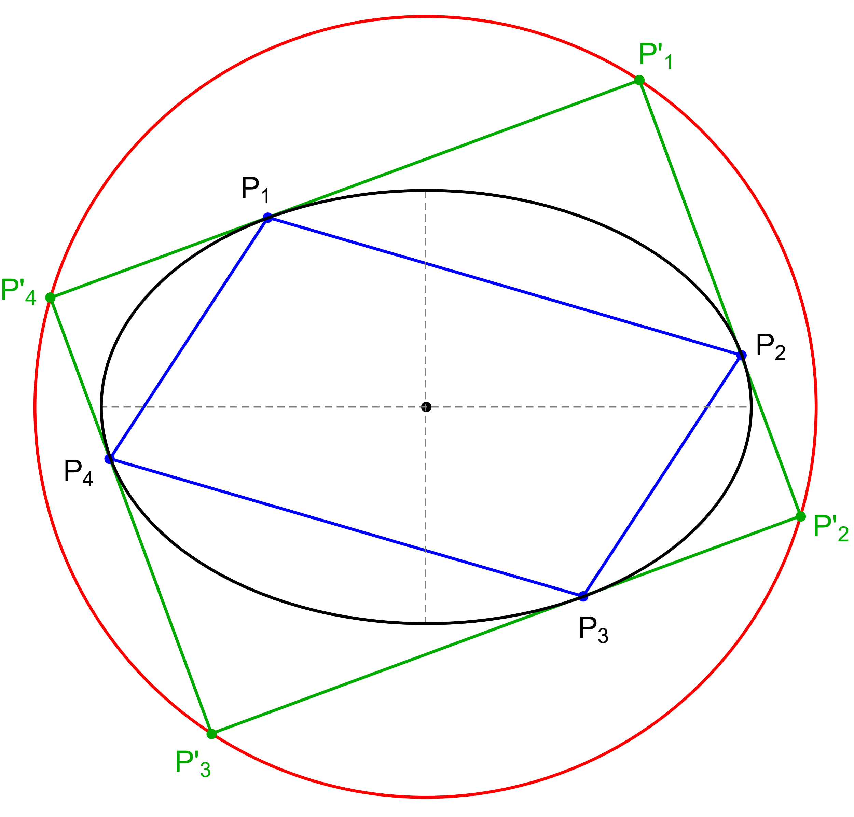
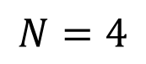
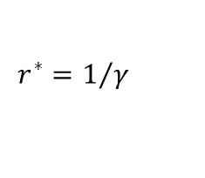
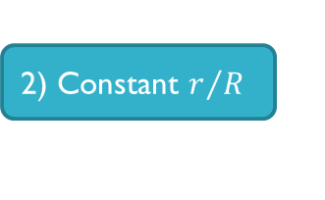
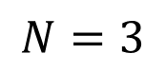
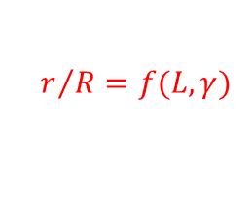
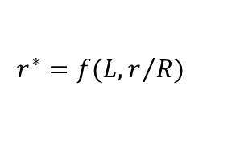
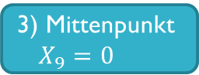
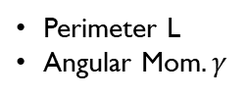
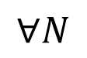
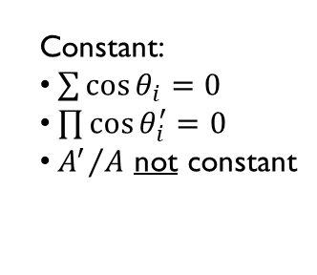
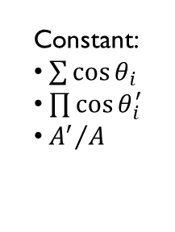
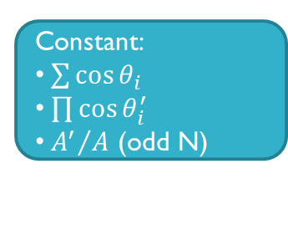
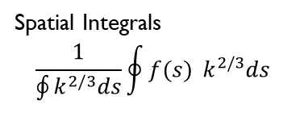
$$N=3$$
$$N=4$$
$$∀N$$
1) Loci
3) Mittenpunkt $X_{9}=0$
Generalized Mittenpunkt
Elliptic
Non-Elliptic
Quasi-Elliptic
Point
Circle
Circumbilliard
Monge’s orhtoptic
0) Integrability
constants
4) Stationary Cosine Circle
Generalized Stationary Circle
Perimeter L
Angular Mom$. γ$
$$r^{∗}=f(L,r/R)$$
$$r^{∗}=1/γ$$
2) Constant $r/R$
$$r/R=f(L,γ)$$
Constant:
$\sum{\cos{θ_{i}}}$
$\prod{\cos{θ_{i}^{′}}}$
${A^{′}}/A$
Constant:
$\sum{\cos{θ_{i}=0}}$
$\prod{\cos{θ_{i}^{′}=0}}$
${A^{′}}/A$ not constant
Constant:
$\sum{\cos{θ_{i}}}$
$\prod{\cos{θ_{i}^{′}}}$
${A^{′}}/A$ (odd N)
Spatial Integrals
$$\frac{1}{\oint{k^{2/3}ds}}\oint{f(s){ k^{2/3}ds}}$$

Slide 16
loci
Elliptic
Non-elliptic
Circular
point

Slide 17
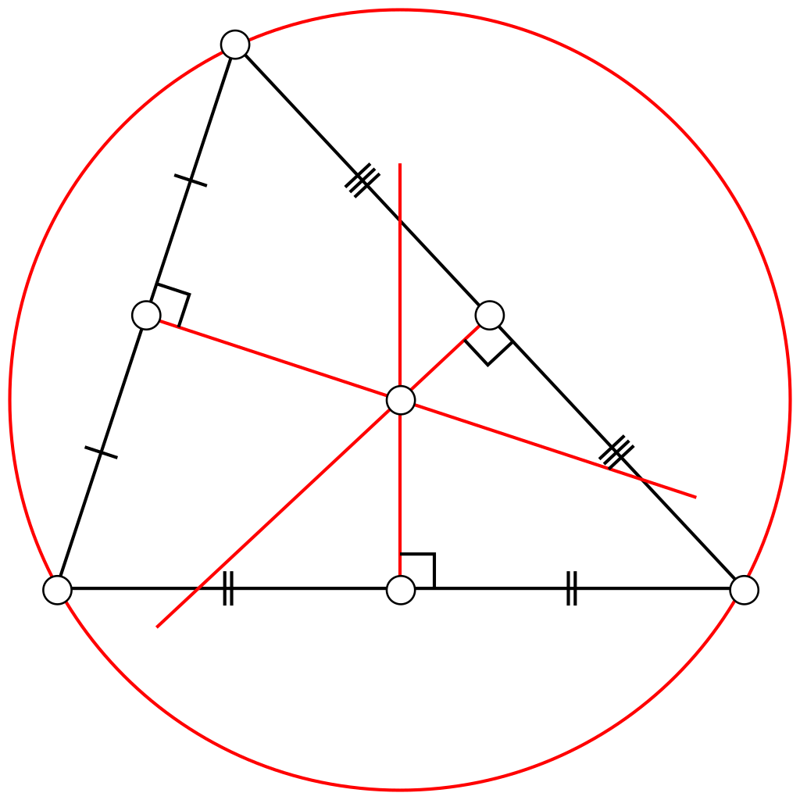



MaJOR Triangular centers
Barycenter
X(2)
Circumcenter
X(3)
Orthocenter
X(4)
9-point center
X(5)

Slide 18


LOCUS OF INCENTER IS ELLIPTIC, 2013 PROF. Olga Romaskevich, uNIVERSITÉ de RENNES, FRANCE PDF

Slide 19


LOCUS of CIRCUMCENTER IS ELLIPTIC, 2016 (I) PROF. RONALDO GARCIA UNIVERSIDADE de GOIÁS, BRAZIL PDF

Slide 20


LOCUS of CIRCUMCENTER IS ELLIPTIC, 2019 (II) CORENTIN FIEROBE, ENS-LYON, FRANCE PDF

Slide 21



LOCUS OF BARYCENTER (for all N) is ELLIPTIC, 2016 PROFS. RICHARD Schwartz (BROWN) & SERGEI Tabachnikov (PENN STATE) PDF

Slide 22


Kimberling’s Encyclopedia of triangular centers (ETC)

Slide 23

ETC II

Slide 24

Hunting for invariants

Slide 25

Elliptic LOCI VIDEO
Euler
line

Slide 26

Non-elliptic

Slide 27
X(6): Quasi-elliptic (quartic) locus

Slide 28


Feuerbach’s theorem
extouch points
Karl Wilhelm Feuerbach
1800-1834
X(11)

Slide 29

1) X11 = CAUSTIC 2) X100 = Billiard 3) EXTOUCHPTS = BILLIARD (in reverse!) VIDEO

Slide 30

Non-elliptic loci: 1) Median 2) intouch 3) Feuerbach TRIANGLE VIDEO

Slide 31


Circular locus
$$r^{∗}=\frac{L}{\frac{r}{R}+4}$$

Slide 32
mittenpunkt
A point locus

Slide 33


Hunting for a fixed point
Christian Heinrich von Nagel
(1803–1882)

Slide 34


THE locus of the Mittenpunkt is the center of the billiard VIDEO

Slide 35

proof sketch (PROF. Olga Romaskevich)
affine

Slide 36


A new invariant: $r/R$
And its corollaries:
$\sum{\cos{θ_{i}}}$
$\prod{\cos{θ_{i}^{′}}}$
${A^{′}}/A$

Slide 37


Three little CIRCLES
R
$$r_{9}$$
r

Slide 38

COMPARING Radii
known
proportionality
???

Slide 39


Scatter inradius vs. Circumradius $$\frac{r}{R}=γL−4$$

Slide 40





WONDER IDENTITY
circumcircle
R
billiard
$$θ_{2}$$
r
$$θ_{1}$$
$$\frac{r}{R}+1=\sum_{i=1}^{3}{θ_{i}}$$
incircle
$$θ_{3}$$

Slide 41

Sum of cosines = constant
θ

Slide 42

May 6th, 2019
From: <Dan> To: <Sergei>
Dear Sergei, the r/R and sum of cosines is constant over all orbits!
From: <Sergei> To: <Dan>
Dear Dan, sorry to disappoint you: this identity holds in every triangle (without relation to billiards)
From: <Dan> To: <Sergei>
Dear Sergei, we were aware of the identity. But they are both staying constant over all orbits!
From: <Sergei> To: <Dan>
Oh, I see: the claim is that for a triangular orbit the sum of cosines is an integral. This is new to me.
$$\frac{r}{R}+1=\sum_{i=1}^{3}{θ_{i}}$$

Slide 43



Corollary I: conservation of excentral COSINE product
$$θ_{i}^{′}$$
orthic
$\left|\cos{θ_{1}^{′}}\cos{θ_{2}^{′}}\cos{θ_{3}^{′}}\right|$= $\frac{r_{h}}{{4R}_{h}}$
orbit is orthic
$$H^{′}=I$$

Slide 44

Corollary III: Cosine circle is stationary VIDEO 1 VIDEO 2

Slide 45



Corollary II: conservation of excentral-to-orbit AREA RATIO
$$A_{e}$$
$\frac{A_{e}}{A_{h}}$= $\frac{{2R}_{h}}{r_{h}}$
$$A_{h}$$

Slide 46
a monge miracle
for N>3

Slide 47


N=4: Monge’s orthoptic circle video
Gaspard Monge
(1746–1818)

Slide 48
Clues to N>3 generalization
The locus of orthoptic points is a stationary circle.
Extend tangents from a point on locus, these define a rectangle: product of cosines is zero
Four tangency points form a parallelogram: sum of cosines is zero.
Lines from Tangential Polygon's vertices through parallelogram midpoints concur at the Ellipse's center.

Slide 49


Conversation with jair May 29, 2019.
N=3: Triangle
N=4: Parallelogram
r/R = 1+cosA+cosB+cosC
Consecutive angles supplementary:
So: cosA+cosB+cosC+cosD=0
Conserves cosine “sum”
r/R = constant
Dan: Could it work?
Jair: Try it!!!
N=5: Pentagon
cosA=-cosB, cosC=-cosD

Slide 50


N=5 works!!!

Slide 51


N=3~100 also CONSERVEs $\sum{\cos{θ_{i}}}$

Slide 52


Slide 53


Slide 54


July 3rd, 2019
From: <Sergei>, To: <Dan>
Dear Dan: Richard and I have a proof that the sum of cosines is constant. Best, Sergei
From: <Dan>, To: <Sergei>
Wizardry!

Slide 55





SKETCH OF PROOF (TABACHNIKOV et al.)
$$P_{i}$$
Joachimsthal
$$α_{i}$$
$$−∇f(P_{i})$$
$\cos{α}{=−\frac{∇f.\hat{v}}{\left|∇f\right|}=\frac{c}{\left|∇f\right|}}$ ; $\cos\left(2α\right)=2 {(\cos{α})}^{2}−1$
$\sum{cos⁡({2α}_{i})}=2c\sum{\frac{1}{{|∇f(P_{i})|}^{2}}−N}$
Complexify and analyze the poles of $\sum{\frac{1}{{|∇f(P_{i})|}^{2}}}$ over orbit as function on elliptic curve covering the conic
Show complex poles of $\sum{\frac{1}{{|∇f(P_{i})|}^{2}}}$ cancel each other
So one has a meromorphic function without poles, hence a constant.
In fact, there are $\frac{n−1}{2}$ conserved quantities.
Prove: $\sum{cos⁡({2α}_{i})} is constant$

Slide 56

July 25th 2019 TANGENT POLYGON CONSERVES *PRODUCT* OF COSINES

Slide 57



August 19th, 2019
Area Ratio between Tangential Polygon and Orbit is Conserved but only for N odd.
$$\frac{A′}{A}=k$$
Prof. Arseniy
Akopyan

Slide 58

Generalized mittenpunkt for N>3

Slide 59


STATIONARY CIRCLES FOR ALL! VIDEO
$$r^{∗}=\frac{1}{γ}$$

Slide 60
computational setup
Numerical playground

Slide 61

Experimental Playground LINK

Slide 62

Hunting 2

Slide 63











ETC

Slide 64


Slide 65


Slide 66
My learning process
Learning
(re)Discovering
Curiosity
Experimentation

Slide 67

MAIN results & Questions
Loci
Elliptic
Non-Elliptic, Quartic
Invariants
Stationary Mittenpunkt, Circles
$\sum{\cos{θ_{i}}}$
$\prod{\cos{θ_{i}′}}$
${A^{′}}/A$
Open questions:
Explain elliptic vs non-elliptic loci
Non-euclidean invariants?

Slide 68

Our Webpage: bit.ly/2JISAQ1

Slide 69

MEDIA gallery LINK

Slide 70

THANKING mathematicians
Prof. Olga
Romaskevich
Prof. Igor
Minevich
Prof. Richard
Schwartz
Corentin
Fierobe
Prof. Arseniy
Akopyan
Prof. Sergei
Tabachnikov

Slide 71

Thanking co-authors / mentors

Slide 72



Thanking Friends at impa
Prof. Paulo Ney
de Souza
Prof. Jorge P.
Zubelli

Slide 73


Thank you

Slide 74
Appendix
Feuerbach phenomena

Slide 75


Slide 76


Slide 77


Slide 78


Slide 79


Slide 80


Slide 81
Prof. Igor Minevich
Boston College

Slide 82
Appendix
Stationary circles

Slide 83

In general loci are non-elliptic GALLERY w/ 700 LOCI

Slide 84

Meet the cosine circle link
=X(6)

Slide 85


Corollary III: cosine circle is stationary! VIDEO 1 VIDEO 2

Slide 86

Can you get A circle FROM AN ellipse?

Slide 87


Poncelet-Darboux grid VIDEO
Jean-Gaston Darboux
1842-1917

Slide 88

Monge-darboux circles: A common rule VIDEO
Jean-Gaston Darboux
1842-1917

Slide 89
I didn’t know this fact, and I don’t know whether it’s new. However, here is an easy proof. --Sergei, July 13, 2019
This new phenomenon doesn't seem to follow from the Poncelet Grid [...] I don't really see how to prove this circle result right away. --Richard, July 16, 2019
This is a very nice fact. I did not know it before. Theorems of this type can be seen by analyzing a projective Poncelet picture. --Arseniy Akopyan, July 13, 2019

Slide 90

Symmedian point X(6)

Slide 91


Slide 92

SYMM of excentral = MITTEN of reference
K’=M

Slide 93


Radius of cosine circle is non-linear on sides
a
c
$$r_{cc}=\frac{a b c}{a^{2}{+b}^{2}+c^{2}}$$
$$r_{cc}$$
b

Slide 94
Appendix
conservation equations

Slide 95





Slide 96



Slide 97

Joachimsthal: M₁ M₂ is conserved

Slide 98





To prove these relationships, just get the coordinates of X_{o}

Slide 99





Slide 100




Slide 101
overflow
Slides not used

Slide 102
summary: Monge’s orthoptic circle: gateway from N=3 => all N
N=3 Invariants:
Elliptic Loci
Stationary Mittenpunk
Constant r/R
Sum Cosines
Product of Exc Cosines
Exc-to-Orbit Area Ratio
Stationary Cosine Circle
N>4 Invariants:
Excentral Medians Meetpoint
Orbit Cosine Sum
Tangential Cosine Product
Area Ratio (odd N)
Stationary Circles
Spatial Integrals
Mean Cosines
Mean Product
Gaspard Monge
(1746–1818)

Slide 103



ELLIPse
$$P=(x,y)$$
$$−∇f(x,y)=−2\left[\begin{matrix}x/a^{2} \\ y/b^{2}\end{matrix}\right]$$
$${f\left(x,y\right)=\left(\frac{x}{a}\right)}^{2}+{\left(\frac{y}{b}\right)}^{2}=1$$

Slide 104

Gaspard
Monge
1746–1818
Jean-Victor
Poncelet
1788–1867
Karl Wilhelm
Feuerbach
1800–1834
Christian Heinrich
von Nagel
1803–1882
Ferdinand
Joachimsthal
1818–1861
Jean-Gaston
Darboux
1842–1917

Slide 105


Slide 106

Constant Inradius/circumradius
R
r

Slide 107


Slide 108



Slide 109



Circumbilliards VIDEO and APPLET

Slide 110
NINE-POINT CIRCLE X(5)
N

Slide 111


Slide 112


Slide 113


LOCUS / LOCI

Slide 114

ELASTIC TRAJECTORY Elliptic BILLIARD applet

Slide 115

Excentral objects: 1) EXCENTRAL TRIANGLE 2) EXCIRCLES 3) EXTOUCHPOINTS

Slide 116

Paul lockhart:
Mathematics is about removing obstacles to our intuition and keeping simple things simple.
Math is not about following directions, it’s about making new directions.

Slide 117

SPIROGRAPH

Slide 118



Garrincha e Bilhares: Já combinou com os Russos?

Slide 119

X(100): ANTICOMPLEMENT of FEUERBACH

Slide 120



Conservation of momentum
$$P=(x,y)$$
$$−∇f(x,y)=−2\left[\begin{matrix}x/a^{2} \\ y/b^{2}\end{matrix}\right]$$
$${f\left(x,y\right)=\left(\frac{x}{a}\right)}^{2}+{\left(\frac{y}{b}\right)}^{2}=1$$

Slide 121


TRILINEAR vs BARYCENTRIC COORDINATES

Slide 122




